Slide 1
rabies

Slide 2
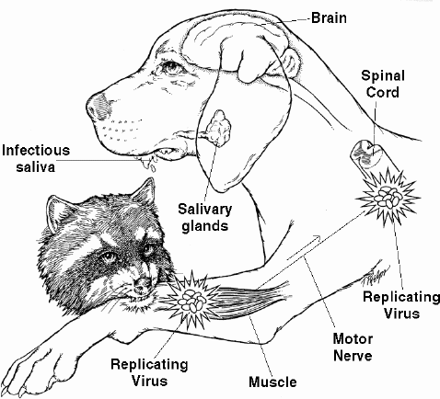
Rabies??? What is that?
Rabies is a viral infection that affects the nervous system of mammals. It causes encephalitis and myelitis. And in just about every case, causes death. Any signalment of animal can be
susceptible to retracting
rabies after being exposed
to it. Canine rabies is
prevalent in Latin America,
Asia and Africa.

Slide 3
Some history for you!
The first written record of rabies is in the Mesopotamian Codex of Eshnunna in 1930 B.C. The Codex states that the owner of a dog showing symptoms of rabies should take preventive measures against bites from the animal. If another person was bitten by a rabid dog and later died, the owner was fined heavily. Contrary to that being the first written record, descriptions of rabies dates back to 1530. There are also hieroglyphics from Egypt.

Slide 4
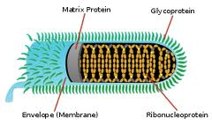
Rabies Make Up.
The rabies virus belongs to the order Mononegavirales. These are viruses with non-segmented, negative stranded RNA genomes. The virus is classified in the Rhabdoviridae family which gives them a distinct shape of a bullet. The Lyssavirus of animal origin is where the rabies virus is located and structured.
When the rabies virus’s envelope fuses with the host cell membrane, it initiates the infection process.

Slide 5
We know what it is, but what does rabies do to the victim?
Stage one- This stage lasts 1-3 days and is known as the “prodromal stage”. It’s characterized by behavioral changes.
Stage two- This stage lasts 3-4 days and is the “excitative stage”. It’s also known as “furious rabies” because of the tendency of the infected animal to be hyperactive to external stimuli and tend to bite at anything near them.
Stage three- This stage is referred to as the “paralytic stage”. It’s caused by damage to the motor neurons and incoordination is seen due to paralysis of the rear limbs. Drooling and difficult swallowing are caused by paralysis of the facial and throat muscles. Death is usually caused by respiratory arrest.

Slide 6
Now, there are two forms of rabies…
One form of rabies is referred to as “furious” rabies. This form consists of aggression and frothing of the mouth. The animal may even attack stationary objects and animals. These outbreaks may alternate with periods of depression.
The other form is “dumb” rabies. Dumb rabies has no mad period. This one usually includes paralysis, typically of lower jaw, and a drooping head. The paralysis will spread to extremities and vital organs. The animal may become depressed and retreat to secluded areas.

Slide 7
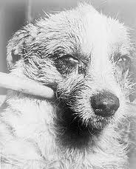
How can I get a sure answer on if my pet has it?
The most used method for diagnosing rabies is by performing PCR or viral culture of brain samples taken
post-mortem. Another method of
diagnosing rabies is to take skin samples.
Though not as sensitive, you can also use
saliva, urine, and cerebrospinal fluid
samples for a diagnosis.
Notes:
samples taken after death. Another method of diagnosing rabies is to take skin samples. Though not as sensitive, you can also use saliva, urine, and cerebrospinal fluid samples for a diagnosis.

Slide 8
There absolutely HAS to be a treatment!
There is no treatment for an animal once it has been infected with the rabies virus. If you can bring in an animal relatively soon after being wounded by a possibly rabid animal then post-exposure prophylaxis can be administered in preventing the virus, generally within 10 days of infection. The prognosis of an animal that has been infected is usually death. There are also pre-exposure preventatives you can give your animals with a vet’s visit.

Slide 9
Preventions
Preventions include vaccinations against the virus.
Keeping pet under supervision.
Keeping it from being in contact with wild animals.
Keep animals on leashes.

Slide 10
Tell me about the tell-tell signs…
Personality and behavioral changes can occur. If it’s a wild animal, they’ll be less prone to avoidance of humans and domesticated animals. An infected animal won’t eat, will become hydrophobic, have fevers, and can acquire an unsteady gait. In later stages paralysis may start caudal of the body and progress cranially. Ptyalism may also occur, along with aggression, cerebral dysfunction, and seizures.

Slide 11
Transmission
The rabies virus can be transmitted by four different ways:
Vertical transmission- contraction from mother to baby
Aerosol-contracted from the air through the respiratory tract
Rabid meat-ingesting animal meat that has rabies(contact of the virus through any cuts or lesions)
Saliva-entry of saliva through bites or scratches or even mucous membranes.
*The most common transmitters for Rabies virus are raccoons, foxes, skunks, coyotes, and bats.

Slide 12
Information for the Civilians
If you believe your animal has fallen victim to effective exposure to the rabies virus, you should take them to your veterinarian as soon as possible for post exposure prophylactic treatment. This method is a preventative so it should be given in a reasonable amount of time, preferably before the virus has a chance to settle and take affect. This virus can acutely or chronically attack the victim so having your pet in for regular check ups would very well be helpful. And if your pet begins to act abnormal for any reason, this too is a reason for a meeting with your veterinarian. Keeping your animal away from other wild animals would be a good idea in trying to prevent rabies also. Keep in mind that rabies is “zoonotic”. This means that it can be transferred to human via animal. If you ever have to deal with a rabid animal, you must take serious precautions.

Slide 13
Cool Facts
Very delicate virus, once the saliva has dried the virus is no longer infectious.
World Rabies Day is September 28th.
The word rabies is derived from Latin rabies meaning “madness”.
Raccoons are the most common carriers of rabies in the U.S.A.
Domesticated animals make up less than 10% of reported rabies cases.
Rabies virus is present not in the blood stream but in the nervous tissue .
Hawaii, England, Australia, Sweden and Japan are rabies free.

Slide 14
“Q & A”
How long is the rabies virus’s incubation period? The incubation period itself for rabies can vary from a few days to several years. Though it’s typically from one to three months.
What is the Codex of Eshnunna?The Codex of Eshnunna are just the laws and orders of Eshnunna.
What is a PCR test? Stands for polymerase chain reaction, this technique amplifies pieces of DNA to examine it and diagnose a disease.
What is ptyalism? Excessive oral salivation
Production.
Is rabies zoonotic? Yes, it is.

Slide 15
References
http://www.wildwoodsurvival.com/survival/health/rabies.html#whatisit
http://www.cdc.gov/rabies/transmission/virus/html
http://en.wikipedia.org/wiki/Rabies_in_animals
Webster’s Encyclopedic Unabridged Dictionary of the English Language
http://www.ndhealth.gov/disease/Rabies/qanda.htm
http://www.felipedia.org/~felipedi/wiki/index.php/Rabies
http://pathmicro.med.sc.edu/virol/rabies.htm

